Slide 1

Mondrian Multidimensional K-Anonymity Data Protection & Privacy Computer Engineering
Authors:
Basso Alessandro
Perasso Bianca

Slide 2

Agenda
1
K-anonymity
Dataset generation
2
3
Mondrian Algorithm
Quality Metrics & Test
4

Slide 3
Agenda
1
K-anonymity
Dataset generation
2
3
Mondrian Algorithm
Quality Metrics & Test
4

Slide 4
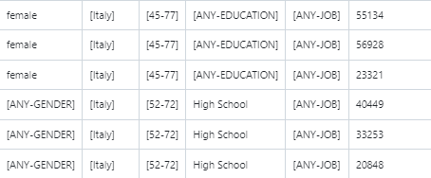
k - Anonymity
K-Anonymization is a technique for preserving individual identification by transforming the record set so that each record of a table identical to at least k-1 other records in terms of quasi-identifying attributes.
K-anonymization is granted by generalizing and suppressing the value of attributes.
Notes:
K anonymity is a data anonymization technique that is used to protect individuals’ privacy in a dataset. A dataset is considered K anonymized when for each record there are at least k - 1 other records with the same values in terms of quasi-identifiers.
We say that k indistinguishable tuples form an equivalence class.
K anonymity works through generalization and suppression.
Generalization: This is a non-perturbative technique and consists in replacing specific values of attributes with less specific, but more generic values.
Suppression: it is a perturbative technique where some data values can be removed altogether to avoid the risk of identification.

Slide 5
Agenda
1
K-anonymity
Dataset generation
2
3
Mondrian Algorithm
Quality Metrics & Test
4

Slide 6
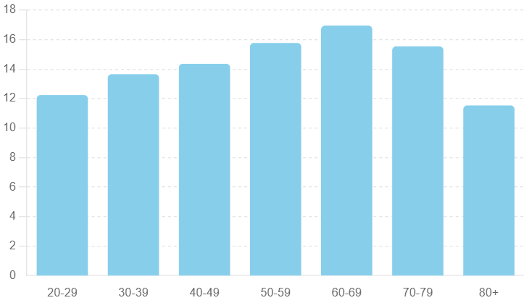
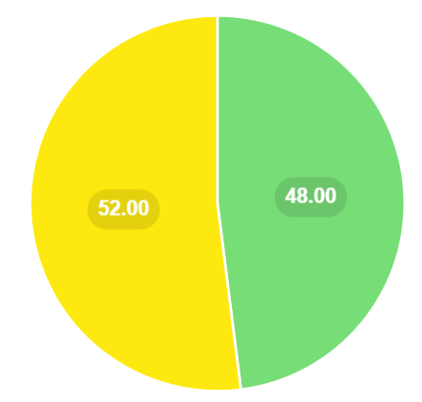


Dataset Generation
The dataset was generated following the Italian distribution regarding gender, age, level of education, type of work relative to the level of education and average annual salary relative to the type of work [1].
Age distribution
Gender distribution
Notes:
To try out our code we generated a synthetic dataset that represents people information about their name, their id, the city where they live in, their age, their gender, their education level, their profession and their annual income.
The dataset was generated following the Italian distribution retrieved at ISTAT web page (national institute of statistics).

Slide 7
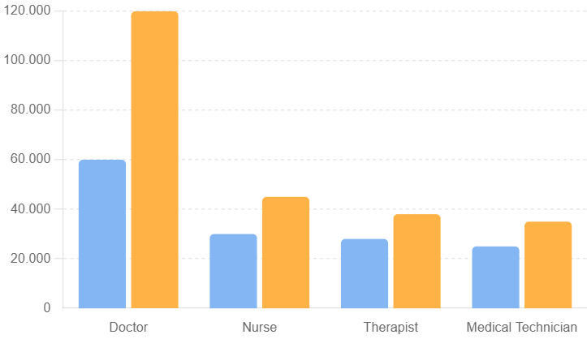
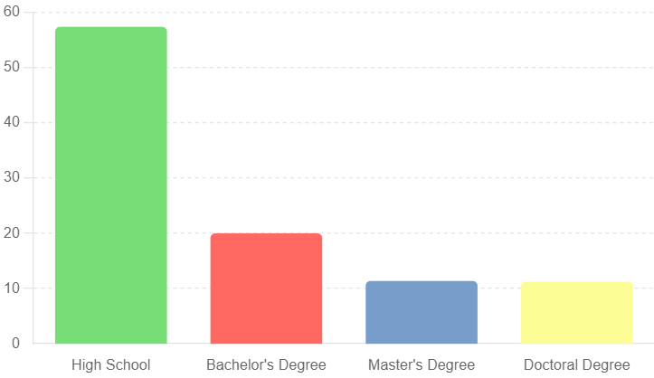

Dataset Generation
The dataset was generated following the Italian distribution regarding gender, age, level of education, type of work relative to the level of education and average annual salary relative to the type of work [1].
Health income distribution
Education distribution

Slide 8
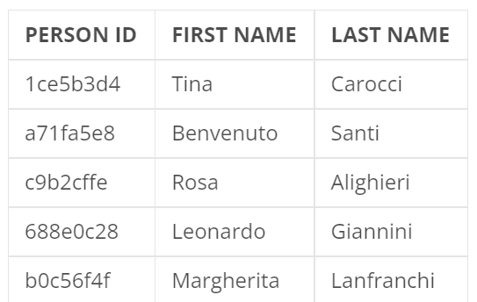
Explicit Identifier
Explicit identifer are attributes that uniquely allow to identify an individual record.
In order to protect individual privacy Explicit identifier must be removed.
Notes:
In our dataset, the explicit identifiers are ID, first name, and last name. Since they allow immediate re-identification of a target, they must be removed.

Slide 9
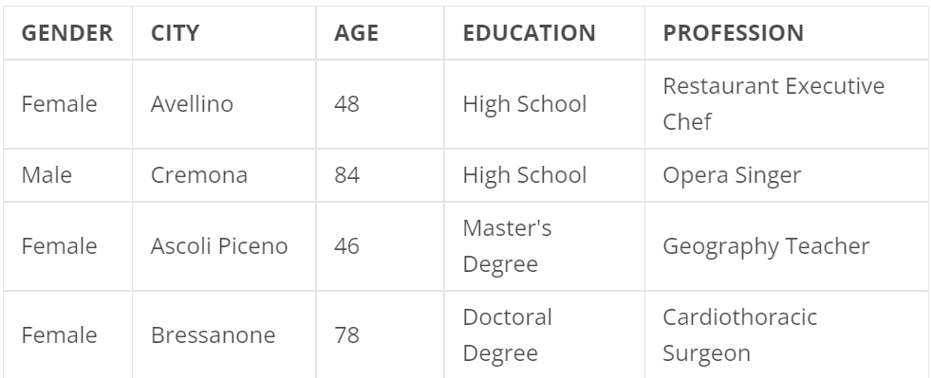
Quasi Identifier
Quasi identifier are attributes that can be joined with external information to identify an individual record. In order to protect individual privacy Explicit identifier must be anonymized:
Numerical attributes with Range or Mean
Categorical attributes with generalizitation
Categorical
Numerical
Notes:
Quasi-identifiers are attributes that do not allow immediate re-identification of a target, but if combined with each other or with external information, they can enable identification. To prevent this, they must be anonymized. Quasi-identifiers are divided into numerical and categorical. Numerical QIs are anonymized by replacing them with the range or the mean of that partition, while categorical QIs are replaced with a generalized attribute.

Slide 10
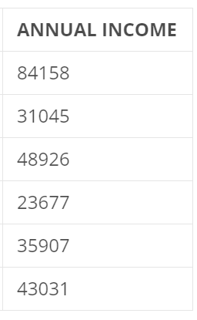
Sensitive Attributes
Sensitive attributes contain confidential information which cannot be compromised at any cost.
In order to preserve the utility they should be kept original.
Notes:
Sensitive data are attributes that must not be associated with an individual in any way because they are confidential. However, it is important to preserve their utility for analysis purposes, so they should remain unchanged.

Slide 11
Agenda
1
K-anonymity
Dataset generation
2
3
Mondrian Algorithm
Quality Metrics & Test
4

Slide 12
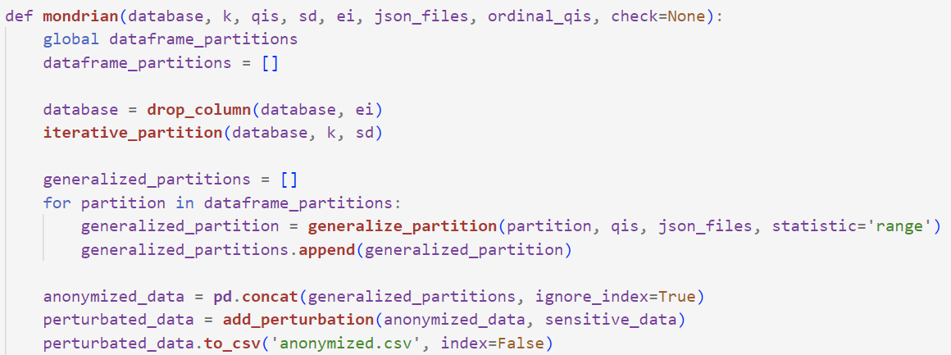
Mondrian Alghoritm
The mondrian algorithm executes:
REMOVAL EXPLICIT IDENTIFIER
PARTITIONING
GENERALIZATION
PERTURBATION
Notes:
The Mondrian method for anonymization works by removing Explicit identifiers. Then partitioning the database iteratively based on quasi-identifiers until each partition satisfies k-anonymity. Partitions are generalized and combined into a single anonymized dataset, which is then saved as a CSV file. Optionally, checks for k-anonymity and statistical analysis can be performed to ensure data utility and privacy.

Slide 13
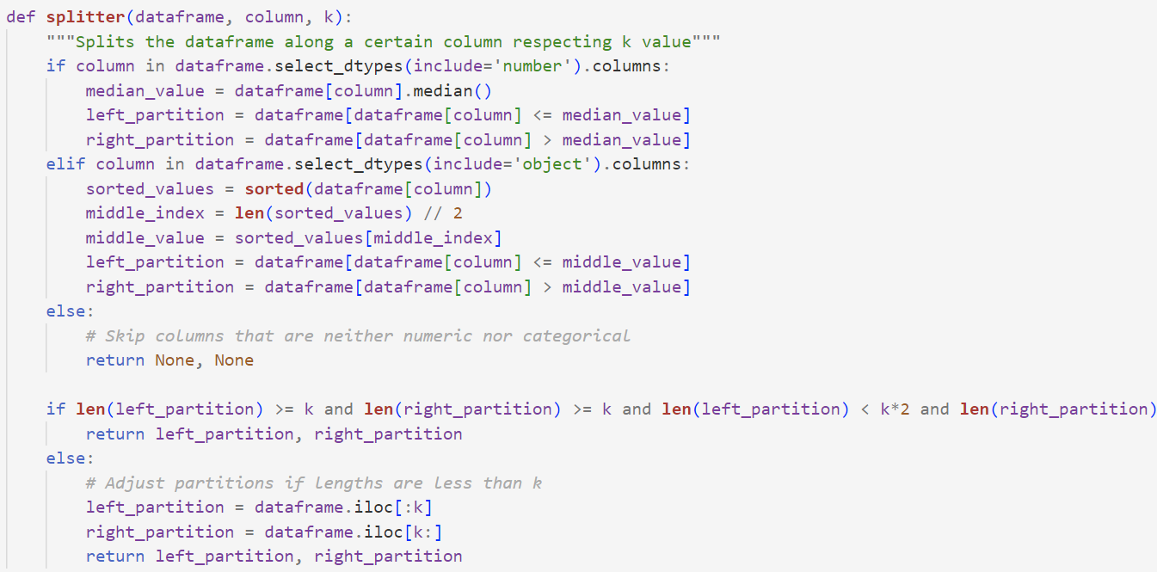
Partitioning
This function does:
Splitting by median if column is numerical
Splitting by middle value if columns is categorical
Notes:
To implement partitioning, we create this function splitter.
This function divides the dataset along a certain column, checking if it’s categorical or numerical.
If the column is numerical, splitting is done by the median value, otherwise, if the column is categorical, it uses the central value.
After partitioning, the function verifies that both partitions have at least k elements and less than 2k elements. If this condition is not met, the partitions are adjusted.
This function is called iteratively until obtaining partitions that respect the criteria of k-anonymity.

Slide 14
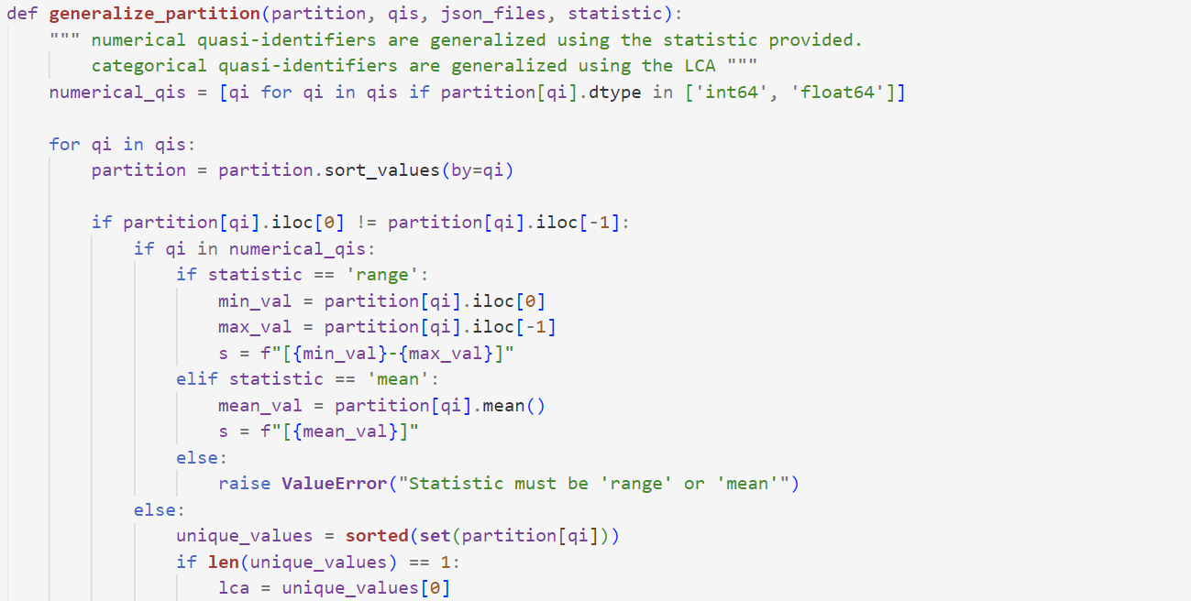
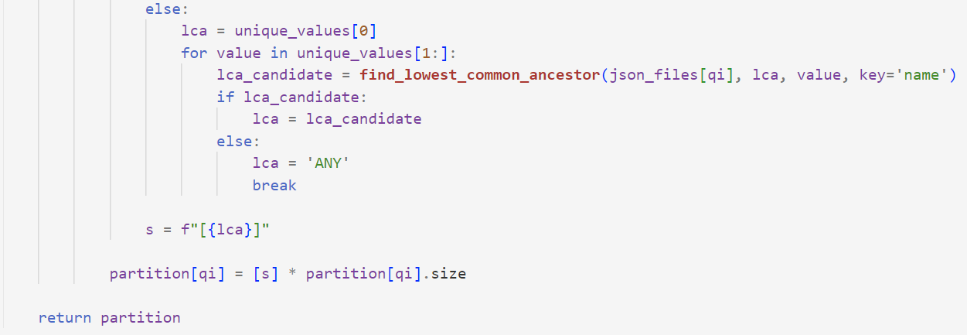
Generalization
Categorical columns are generalized by finding the lowest common ancestor in a JSON file.
Notes:
The generalization function generalizes values of quasi-identifiers in each partition.
For each QI, the partition is sorted according to the QI values. If all values of an IQ are identical, no generalization is necessary. If the values are different, generalization is used.
If the value is numerical, it generalizes by using range or mean.
If the value is categorical, it finds the lowest common ancestor using json files.

Slide 15
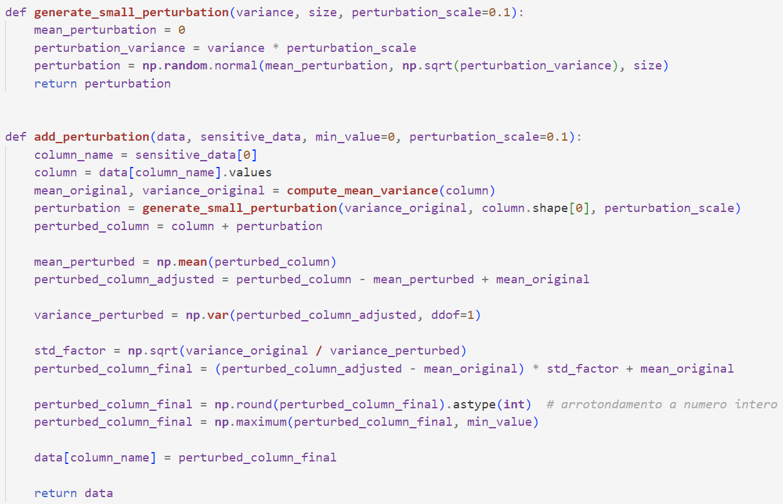
Random Perturbation
A small random disturbance to sensitive data is applied.
The disturbance is generated as a normal distribution with mean zero and variance proportional to the original column variance
Notes:
We know that sensitive data should remain intact in order to preserve utility, but since sensitive data can be used for re-identification, we applied a small random perturbation with zero mean and variance proportional to the original column variance, in this way we still preserve utility.

Slide 16
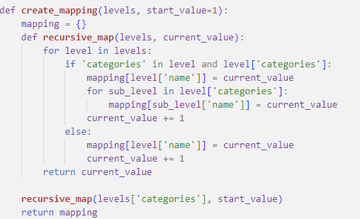
Mapping
In order to compute statystical analysis as mean, variance on categorical attributes, they must be mapped.
This function maps categorical attributes only if they have a hierarchical order.
Notes:
This function creates a numerical mapping for education levels.
It uses a recursive function, recursive map, to cross layers and categories of the layers, assigning a numerical value to each layer.

Slide 17
Agenda
1
K-anonymity
Dataset generation
2
3
Mondrian Algorithm
Quality Metrics & Test
4

Slide 18
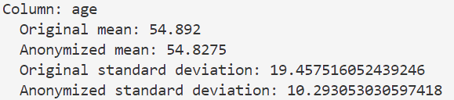
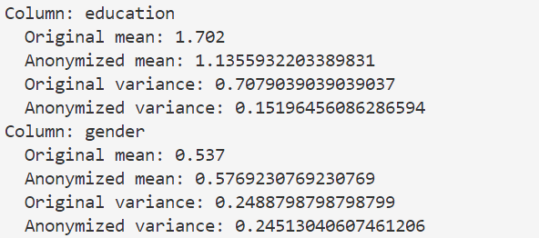
Original vs Anonymized dataset
We did some analysis to evaluate the differences between the original dataset and the anonymized dataset. We computed the mean and the standard deviation per each column, analyzing how much the utility has been preserved during the anonymization.
Numerical attribute:
Categorical attribute:
Notes:
The mean and variance were calculated only for the numerical columns (age) and for the categorical columns (education and gender) since a hierarchical order could be established, giving the mean a meaningful interpretation. As we can see, despite the anonymization, the means and variances remain close to the original values.

Slide 19
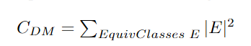
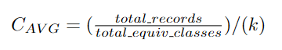
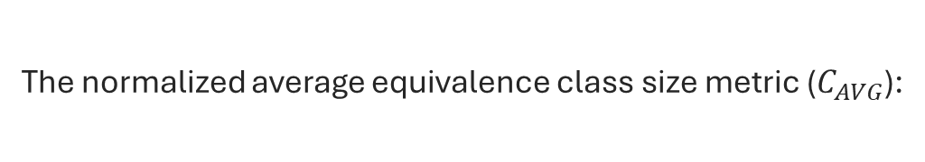
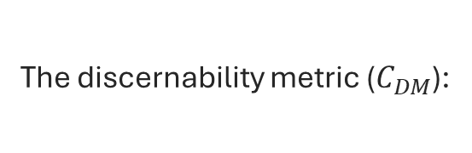
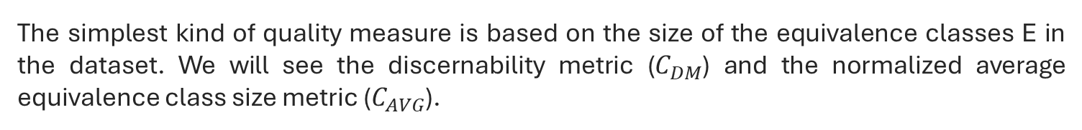
General Purpose Quality Metrics
The simplest kind of quality measure is based on the size of the equivalence classes E in the dataset. We will see the discernability metric ($C_{DM}$) and the normalized average equivalence class size metric ($C_{AVG}$).
The discernability metric ($C_{DM}$):
The normalized average equivalence class size metric ($C_{AVG}$):
It assigns to each tuple t a penalty, which is determined by the size of the equivalence class containing t.
This metric evaluates the average size of equivalence classes relative to the total number of records and the number of equivalence classes, providing insight into the balance between privacy and data utility
Notes:
Discernability Penalty measures the quality of anonymization by penalizing partitions that are too large. It sums the square of the sizes of partitions The resulting score quantifies the "cost" of anonymization, with lower values indicating better balance between privacy and utility.
Equivalence Size Metric calculates the average size of each equivalence class, normalized by the anonymity parameter k. The result helps evaluate the effectiveness of the data partitioning for maintaining privacy. If is ≥1 it indicates that the average size of each equivalence class is at least k, which means each class satisfies the k-anonymity requirement.

Slide 20
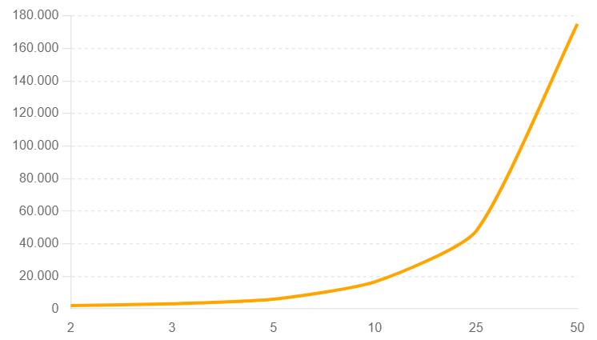
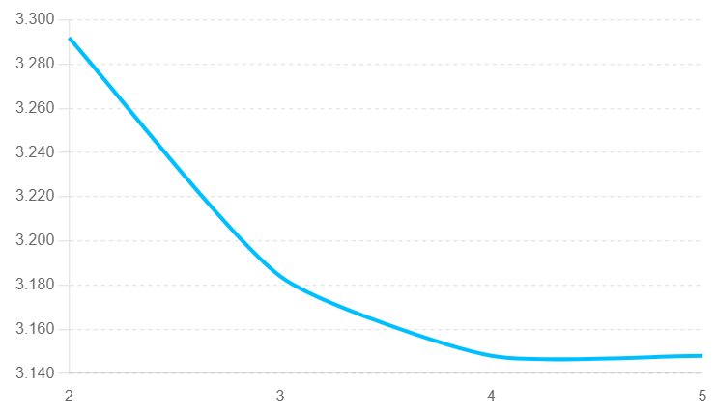


General Purpose Quality Metrics
We evaluated our model by using the discernability penalty metric. The first graph compares the model for varied k. In the second one, we compared the model with different number of attributes.
Notes:
As we can see from the first graph incrasing K increase the dimension of partitions, which leads to higher penalty, reflecting the increase of cost of maintaing k anonymity and a decrease of data utility.
Instead, by increasing the number of attributes the penalty decrease because the panalty is calculated on the square size of partitions, which means better protection against re identification. It decrease because with more attributes the partitions are more detailed.

Slide 21
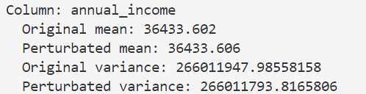
Random Perturbation
Sensitive Data should be not anonymized in order to preserve utility, but in some cases, they can be used for re-identification. Hence, we applied a random perturbation technique.
The mean and variance of both columns are very closed.
Notes:
Random perturbation enhances the anonymity of sensitive data by introducing perturbation based on zero mean and variance on variance of the column, making it harder to re-identify individuals. This technique preserves data utility effectively, as the anonymized data remains very similar to the original data in terms of overall characteristics and statistical properties.

Slide 22
Thank you for your attention!

Slide 23

Grazie per l’attenzione

